Slide 1


2026 NFHS BASEBALL Rules Changes and Points of Emphasis
NYSBUA
Andy Draper

Slide 2
Today’s agenda
NYSBUA President’s Report
Discuss the 2026 Rule Changes
Discuss the 2026 Points of Emphasis
Review the NYS Adopted Rules and Items
Q&A

Slide 3
NYSBUA – President’s Report
October 2025 Meeting Weekend Summary
  Education Committee Presentations
  DeVivo Award Banquet
  Updating chapter maps to post to NYSBUA website
  Election of Officers
    Jeff Holliday (Columbia-Greene) was elected as Sergeant-at-Arms

Slide 4
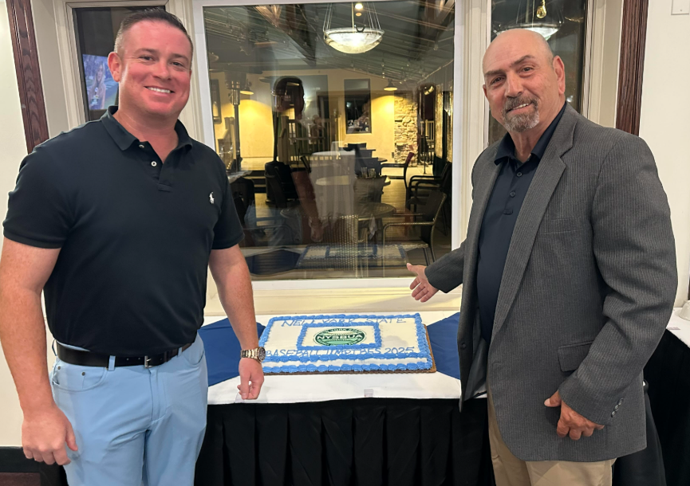
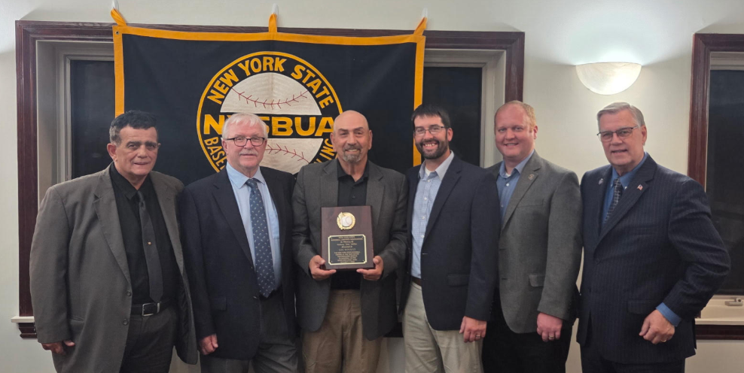
2025 Tony DeVivo award winner
Lou Bonacci – Binghamton

Slide 5

NYSBUA – President’s Report
Review of Approved Uniform Colors
  Black uniform shirt is the default color
  Charcoal gray pants are the only pants approved

Slide 6
NYSBUA – President’s Report
State Tournament Details
  Binghamton will host the 2026 state tournament (June 12 and June 13)
  27 umpires will again be used for the state tournament with 6 classifications
    2026: Sections 5 and 6 will each send 2 extra umpires
  Pre-tournament on-field training and umpire meeting will be Thursday June 11

Slide 7
NYSBUA – President’s Report
Exam Dates
  Part 1 is available through March 31, 2026
  Part 2 available from April 1 through at least June 1
As discussed at the October 2025 Business Meeting, an official must complete and pass the 2026 NFHS exam as part of the certification process to work the 2026 season.

Slide 8
NFHS Information

Slide 9







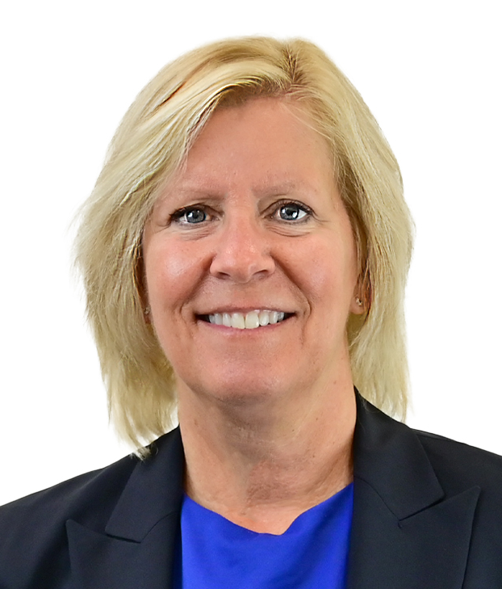

NFHS Rules Review Committee
The NFHS Rules Review Committee is chaired by the chief operating officer and composed of all rules editors. After each committee concludes its deliberations and has adopted its recommended changes for the subsequent year, such revisions will be evaluated
by the Rules Review Committee.
Davis Whitfield
Chief Operating Officer
Lindsey Atkinson
Boys & Girls Lacrosse and Volleyball
Julie Cochran
Cross Country, Soccer and Track & Field
Bob Colgate
Flag Football, Football and Sports
Medicine
Elliot Hopkins
Baseball and Wrestling
Monica Maxwell
Basketball, Field Hockey and Girls Gymnastics
Dan Schuster
Ice Hockey
Sandy Searcy
Softball, Swimming & Diving and Water Polo
James Weaver
Spirit

Slide 10


NFHS Digital
NFHS Digital is the New Publications Platform that includes:
  Rules Books
  Case Books
  Officials Manuals
  Policy Debate Quarterly
  Other NFHS Publications
Visit nfhs.org/NFHSDigital

Slide 11

NFHS Digital – Mobile App
Access via Mobile App:
  View available publications for sale
  View publications assigned to you
  Create comments and save notes
  Highlight important content to review later
  Available on App Store and Google Play

Slide 12
2026 NFHS Baseball
Rules Changes

Slide 13
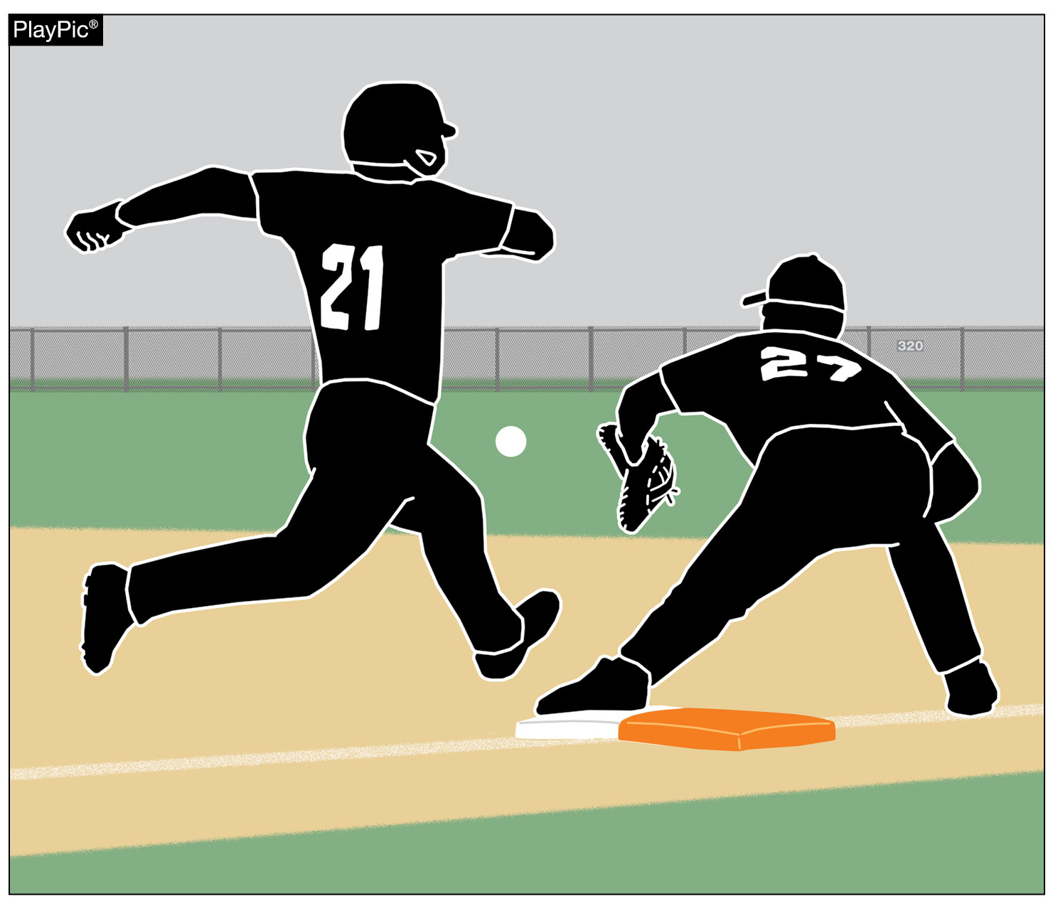
DOUBLE FIRST BASE
1-2-9, 2-5-1h, 2-16-1h, 8-2-1, 8-2-2a(1-7), and 8-2-7
Starting 1/1/2027, all high school baseball fields will be required to use the double first base.
On Feb 4, NYSPHSAA voted to approve the option to use the double first base in 2026.

Slide 14

DOUBLE FIRST BASE 1-2-9

Slide 15
DOUBLE FIRST BASE
1-2-9
The double first base shall be a white base and a contrasting solid color.
The white portion of the base is located in fair territory and the colored portion is located in foul territory. The double first base is split by the first base foul line.
They shall be installed with no space between the two portions of the double first base.

Slide 16
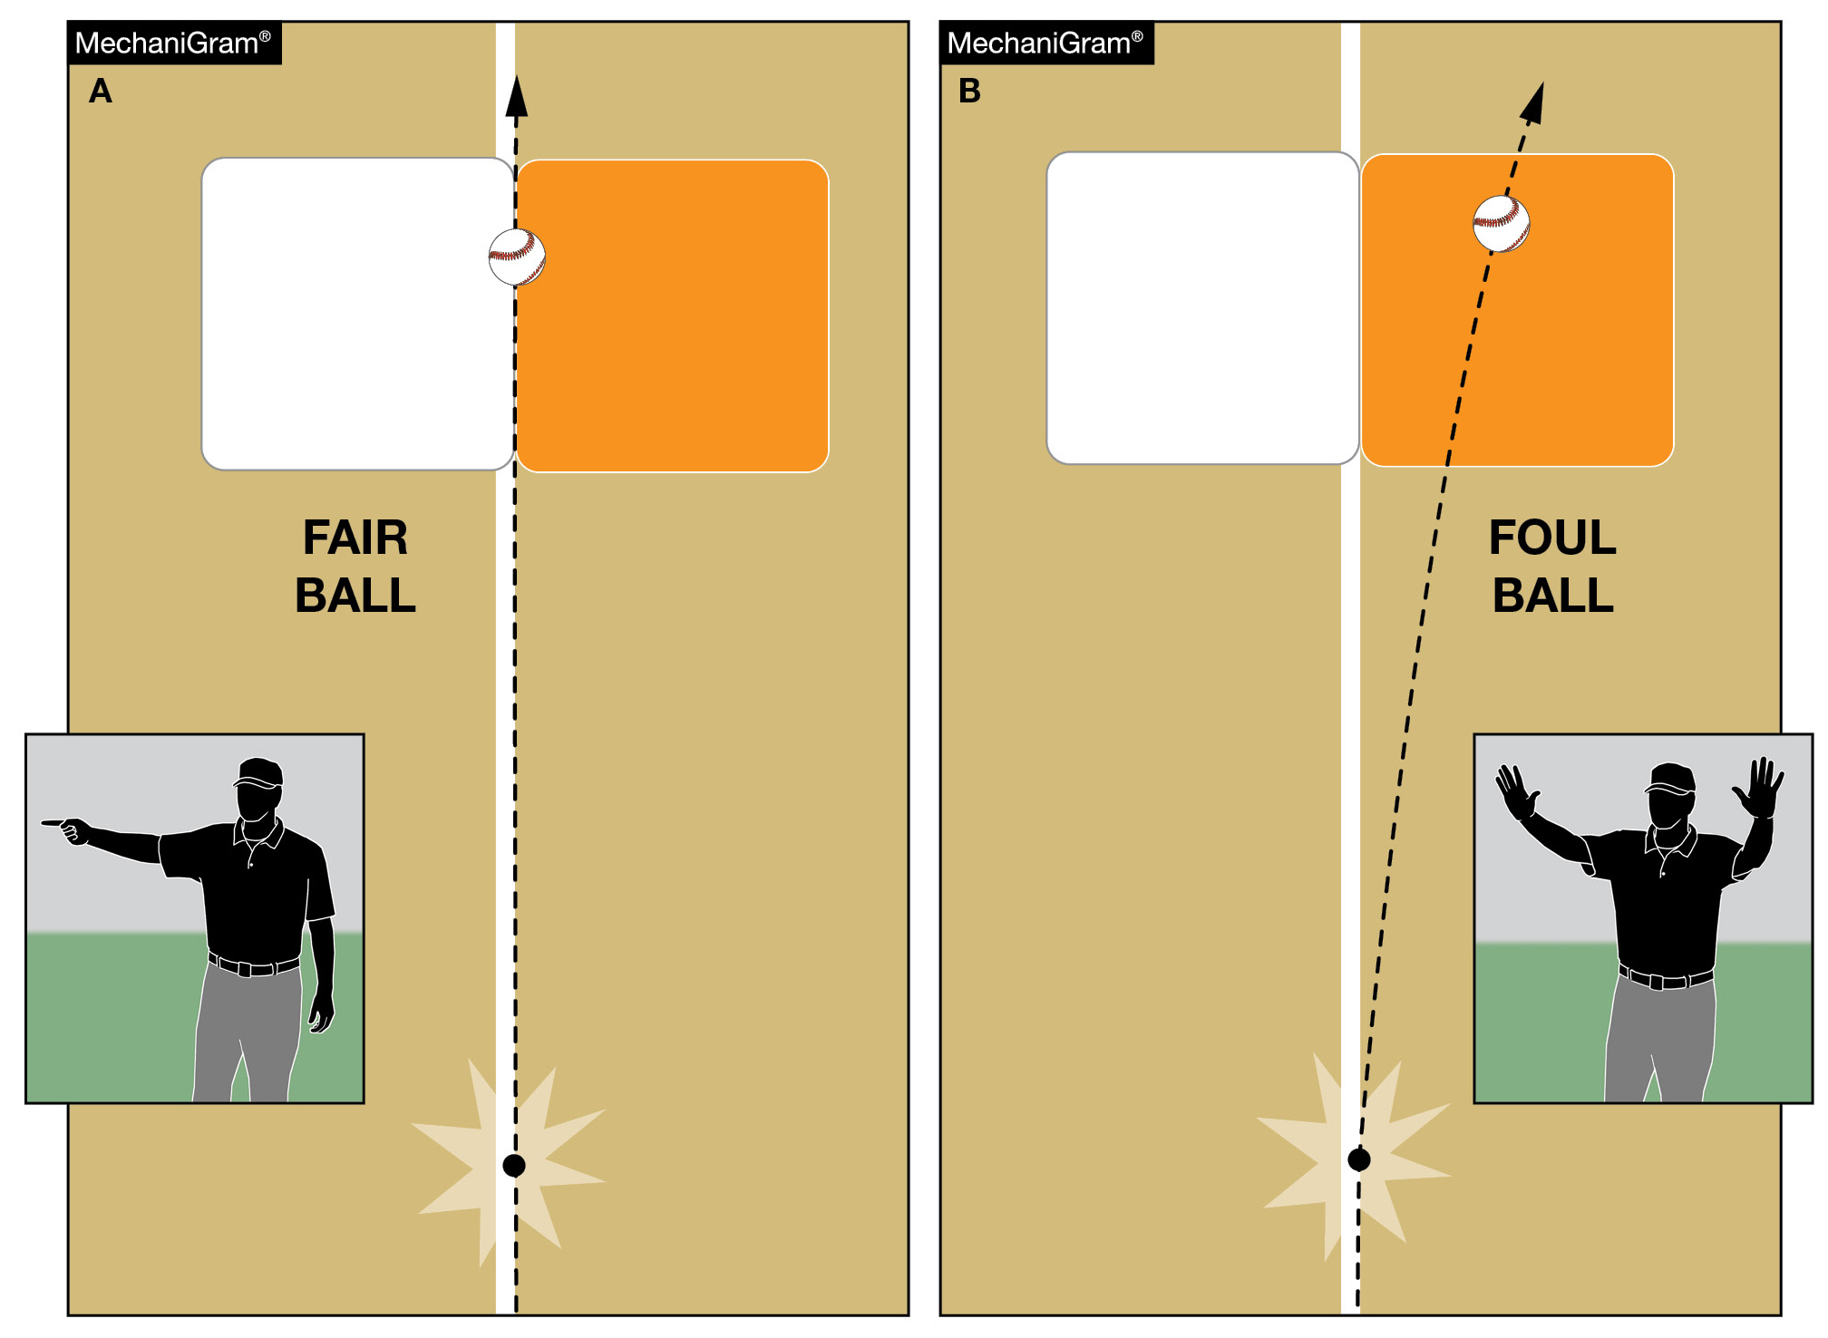
DOUBLE FIRST BASE
2-5-1h, 2-16-1h

Slide 17
DOUBLE FIRST BASE
8-2-1

Slide 18
DOUBLE FIRST BASE 8-2-2a(1-7)
A defensive player may use only the fair portion of the base when a play is being made on the batter-runner on any live ball from within the foul lines or from third base foul line.

Slide 19
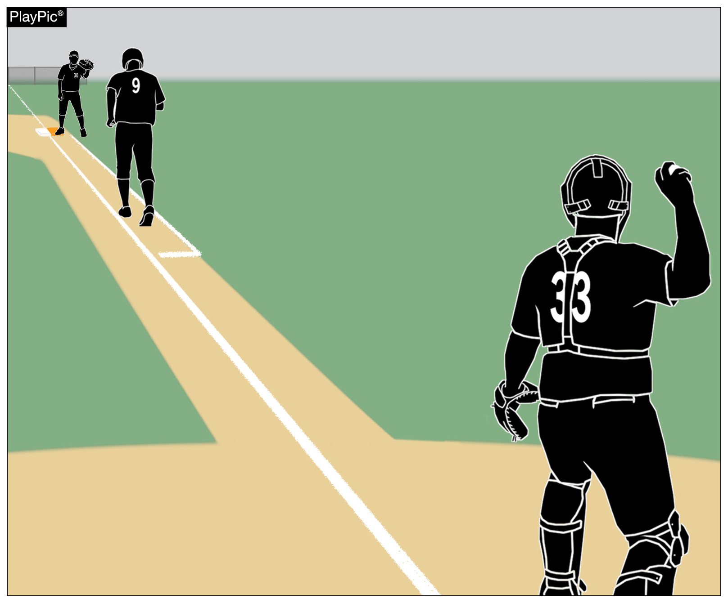
DOUBLE FIRST BASE
8-2-2a(1-7)
The lone exception is when there is a dropped third strike, in which case the batter-runner may use the white portion of the base and the fielder may use the colored portion of the base.
On a dropped third strike, both the fielder and runner may use either portion of the base.

Slide 20
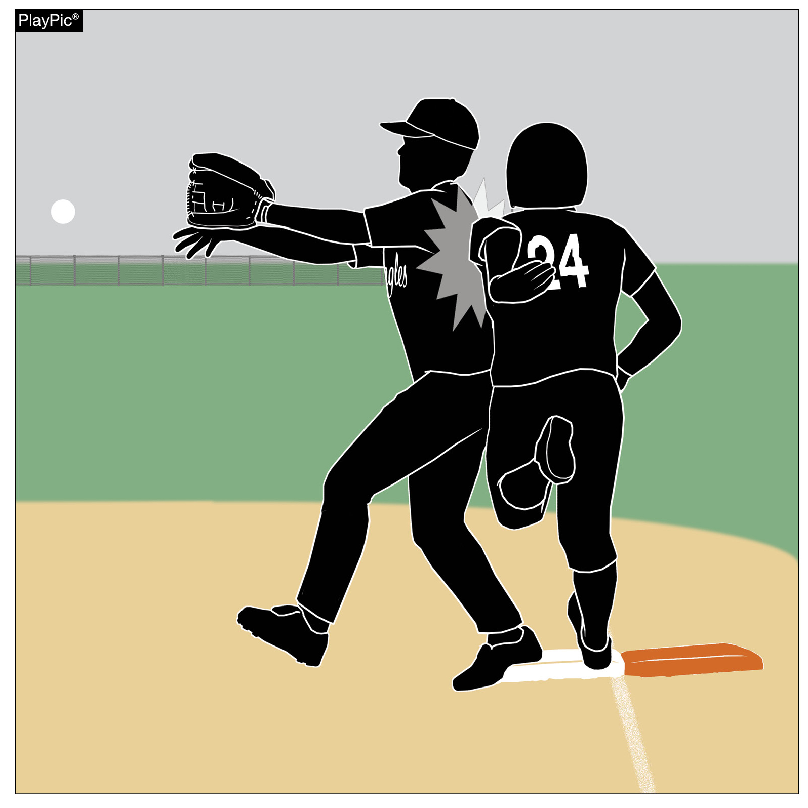
DOUBLE FIRST BASE
8-2-2a(1-7)
If a batter-runner on a force play touches only the white portion of the base and collides with a fielder who is entitled to catch a thrown ball while touching the white portion of the base, interference should be ruled.

Slide 21
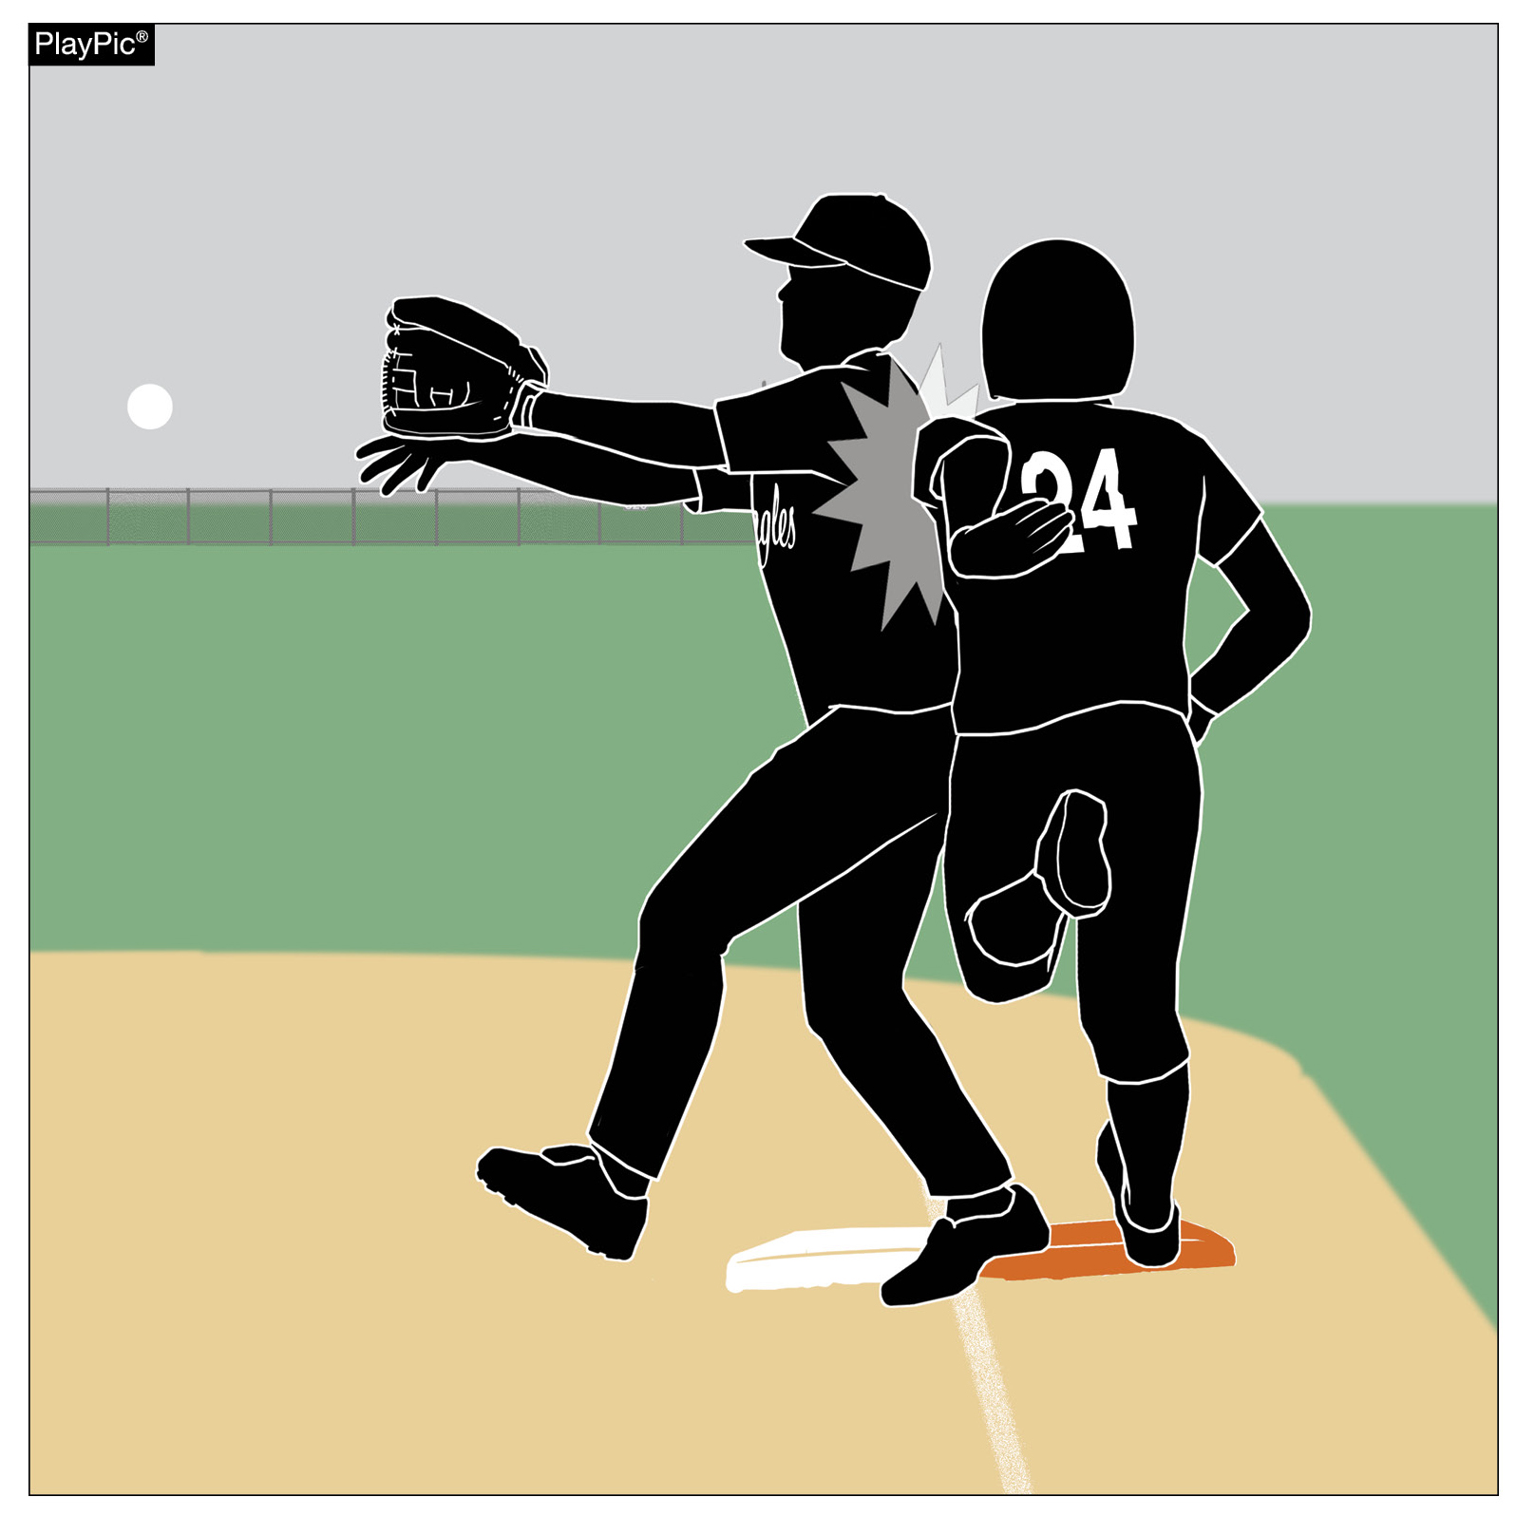
DOUBLE FIRST BASE
8-2-2a(1-7)
If a batter-runner on a force play touches only the colored portion of the base and collides with a fielder who is not legally entitled to catch a thrown ball while touching the colored portion of the base, obstruction should be ruled.

Slide 22
DOUBLE FIRST BASE
8-2-2a(1-7)
The batter-runner should use the colored base on the initial play at first base, unless the fielder is drawn to the colored base because of a dropped third strike, in which case the BR could go to the white base or colored base.
Once the batter-runner reaches first base, the runner must always return to the white base.

Slide 23
DOUBLE FIRST BASE
8-2-2a(1-7)
On extra base hits or other balls hit to the outfield when there is no chance for a play to be made at the double first base, the batter-runner may touch either the white or colored section of the base.
When tagging up on a fly ball, the white section of the base must be used by the runner. One foot is permitted to extend behind or on the colored base provided the front foot is touching the white section of the base.

Slide 24
DOUBLE FIRST BASE
8-2-2a(1-7)
5. On attempted pick-off plays, the runner must return to the white section of the base only.
This includes a throw from the pitcher, catcher, or any other player, in an attempt to retire the runner at the double first base.
6. The double first base does not change any other rule concerning interference or obstruction at first base.
The batter-runner must still avoid interference with the fielder attempting to field a batted ball.

Slide 25
DOUBLE FIRST BASE
8-2-2a(1-7)
7. On base on balls, the offense or the defense may touch either the white or colored base.

Slide 26
DOUBLE FIRST BASE
8-2-7
ART. 7 . . . A batter-runner who reaches first base safely and then overruns or over slides may immediately return without liability of being put our provided the batter-runner does not attempt or feint an advance to second. Once the batter-runner reaches first base (colored), the runner shall use the white base.

Slide 27
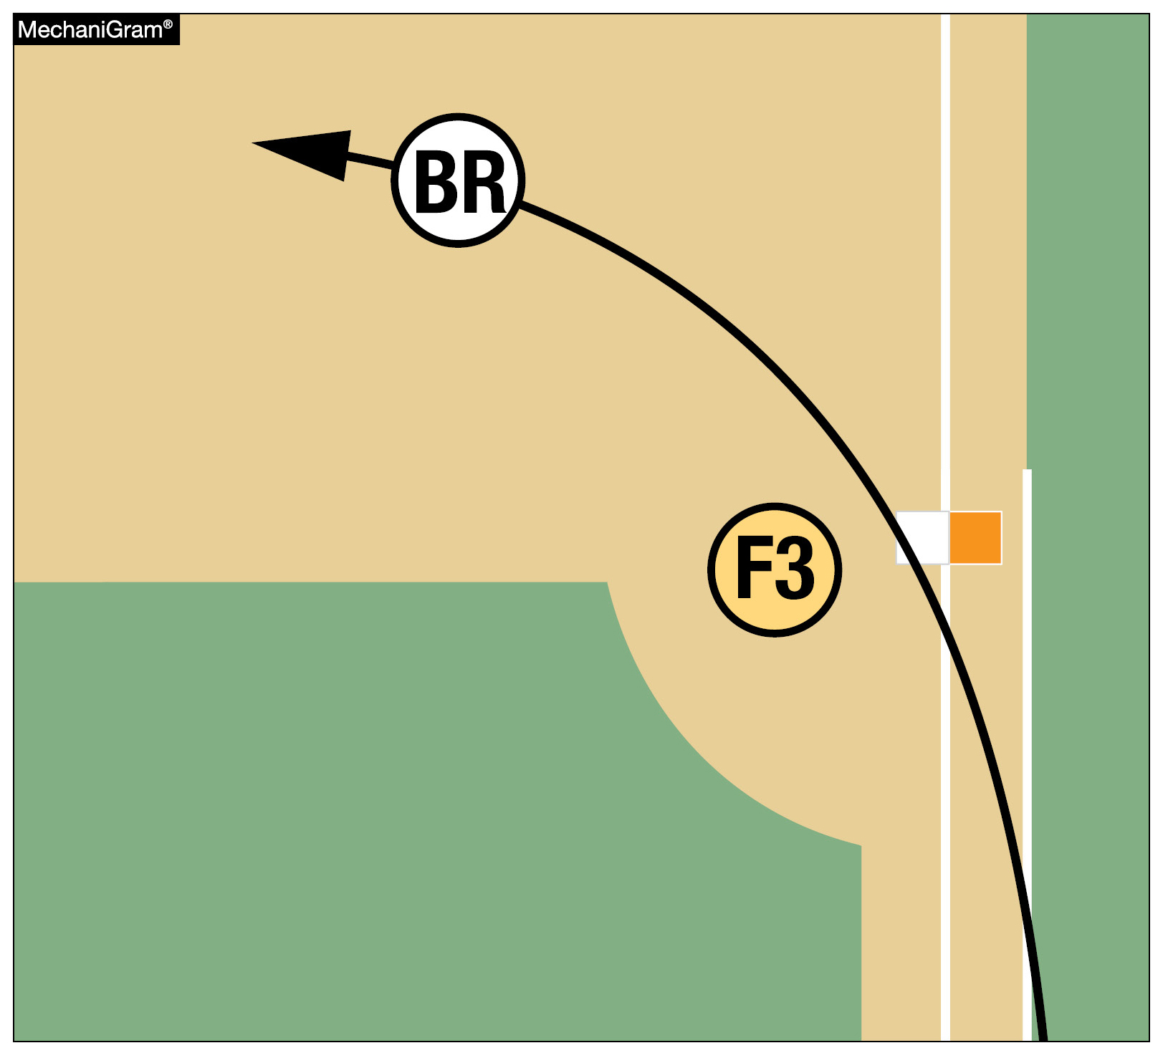
DOUBLE FIRST BASE
1-2-9, 2-5-1h, 2-16-1h, 8-2-1,
8-2-2a(1-7), 8-2-7
On extra-base hits or other balls hit to the outfield when there is no chance for a play to be made at the double first base, the batter-runner may touch either portion of the base.
Once a batter reaches first base safely, the colored portion of the base essentially disappears, and all legal touches of first base require the use of the white portion of the base.

Slide 28
Example Play 1
Grady, the batter, hits a ground ball to SS and beats the throw by 3 steps. However, Grady touched the white portion of the base rather than the color portion of the base as required by rule.
As U1, what should be our mechanic?

Slide 29
Example Play 1 - ANSWER
Make the “safe” mechanic since Grady beat the throw to 1B.
It is on the defense to appeal the “missed” base by the batter-runner (just like it has been).
If a proper appeal is made, call Grady out.
This is our current mechanic for missing 1B by the batter-runner.

Slide 30
DOUBLE FIRST BASE
1-2-9, 2-5-1h, 2-16-1h, 8-2-1,
8-2-2a(1-7), 8-2-7
Rationale: Risk minimization.

Slide 31
Rule 1-4-4
ART. 4 . . . The school's official uniform… (The same restriction shall apply to either the manufacturer's logo/trademark or reference.) Effective, January 1, 2027, The school's name, school nickname, school logo, school mascot, and/or the player's name are permitted on the uniform top and/or pants. One American flag 2 inches x 3 inches may be worn or occupy space on each item of uniform apparel.
Rationale:
This is a universal rule adaptation by every NFHS Rules Committee to be uniformed for every NFHS rule publication.

Slide 32
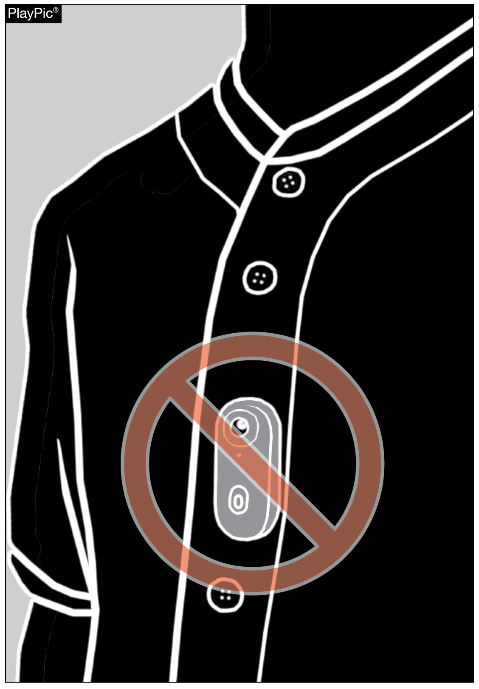
PLAYER EQUIPMENT
Rule 1-6-3

Slide 33
Rule 1-6-3
Articles 1 and 2 remain the same.
ART. 3 . . . No player shall wear any audio (microphone) or video (camera) device during the game.
Rationale: No player participating in the game will be allowed to wear any type of audio or video device to record or transmit audio or video. This is a universal rule adaptation by every NFHS Rules Committee to be uniformed for every NFHS rule publication.

Slide 34
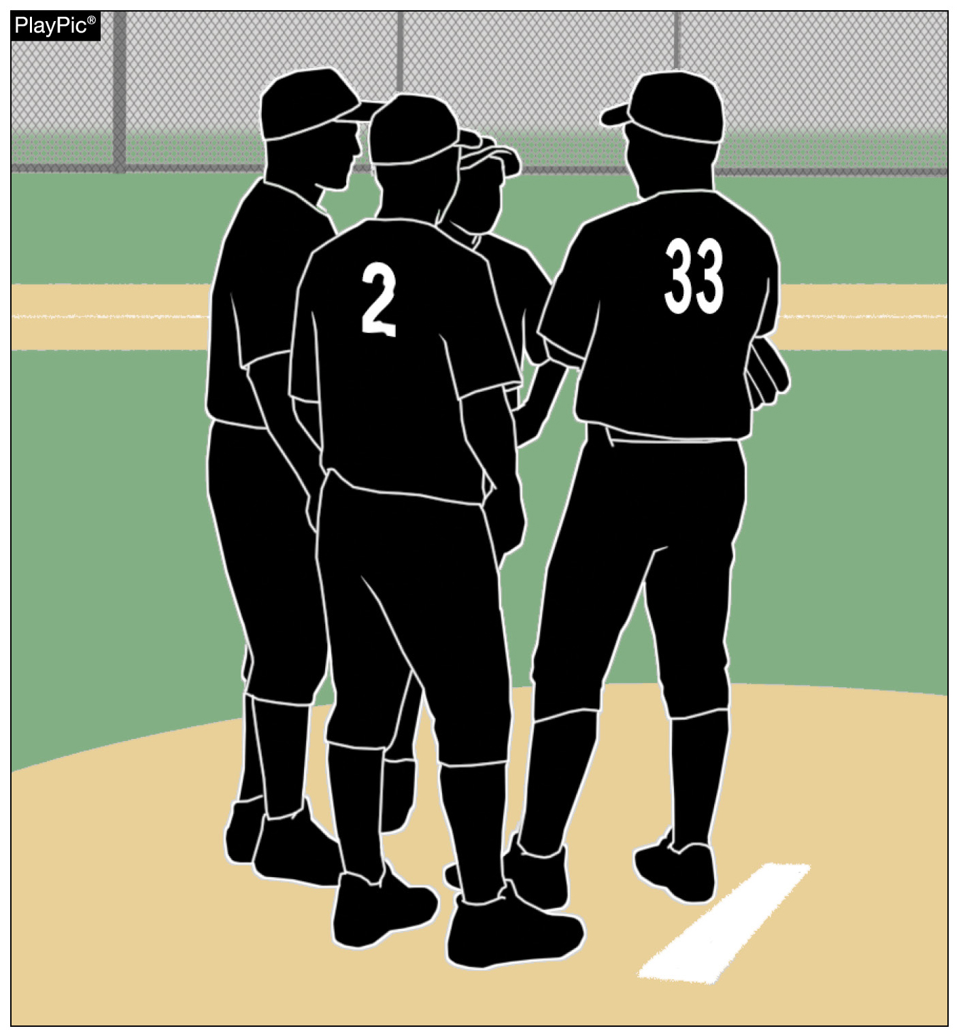
MEETINGS
Rule 2-10-3, 3-4-6

Slide 35
Rule 2-10-3
ART. 3 . . . A player-to-player defensive meeting includes two or more players (3-4-6).
Rationale: Definition for player-to-player meeting.

Slide 36
MEETINGS
Rule 3-4-6
Each team, when on defense, may be granted not more than one player-to-player meeting during an inning to permit players to confer with defensive personnel.
The umpire shall deny any subsequent player-to-player defensive team requests for meetings.
Notes:
The following plays are not defined as player-to-player meetings:
Injury time-outs for either offense or defense. Players will be able to meet without penalty during an injury time-out.
Offensive Time-out – If the offense calls time, the defensive players can meet and not be in violation of the rule.
Other Team Conferences – If the other team conferences, the defensive players can meet and not be in violation of the rule.
After Putout (Outfield) – After a putout in the outfield, with no runners on base, the ball shall be thrown to a cutoff player and if desired to one additional player before being returned to the pitcher. The returner can either throw the ball to the pitcher or walk it to them with words of encouragement or a congratulatory message.
After Putout (Infield or Strikeout) - After a putout in the infield, with no runners on base, the ball shall be returned directly to the pitcher. The returner can either throw the ball to the pitcher or walk it to them with words of encouragement or a congratulatory message.
Fifth Warm-up Pitch– Upon the fifth warm-up pitch at the start of the half-inning, the catcher can either throw the ball to the pitcher or walk it to them with words of encouragement or a congratulatory message.

Slide 37
Rule 3-4-6
Rationale: Utilizing the rule addition will improve the pace of play, while still allowing the meetings to continue. Currently there is not a limit on defensive player-to-player meetings. This will prevent teams from stalling when the weather or darkness is approaching.

Slide 38
Example Play 2
Having already had a defensive player meeting in the inning, the catcher runs out and talks to his pitcher. As the plate umpire goes out to stop the meeting, the opposing coach wants the umpire to charge the defense with a defensive charged conference for this extra meeting.
What is the ruling?

Slide 39
Example Play 2 - ANSWER
A defensive player meeting, even if it is a second meeting in a half-inning, cannot be charged to the team as a defensive charged conference.
Umpires will warn (verbal or written) the head coach that if more than one defensive meeting were to occur in future innings, the head coach may be restricted or even ejected.
NFHS Rule Interpretations Situation 1
  Rules (2-10-3, 3-3-1, 3-4-6)

Slide 40
2026 NFHS Baseball
Points of Emphasis

Slide 41
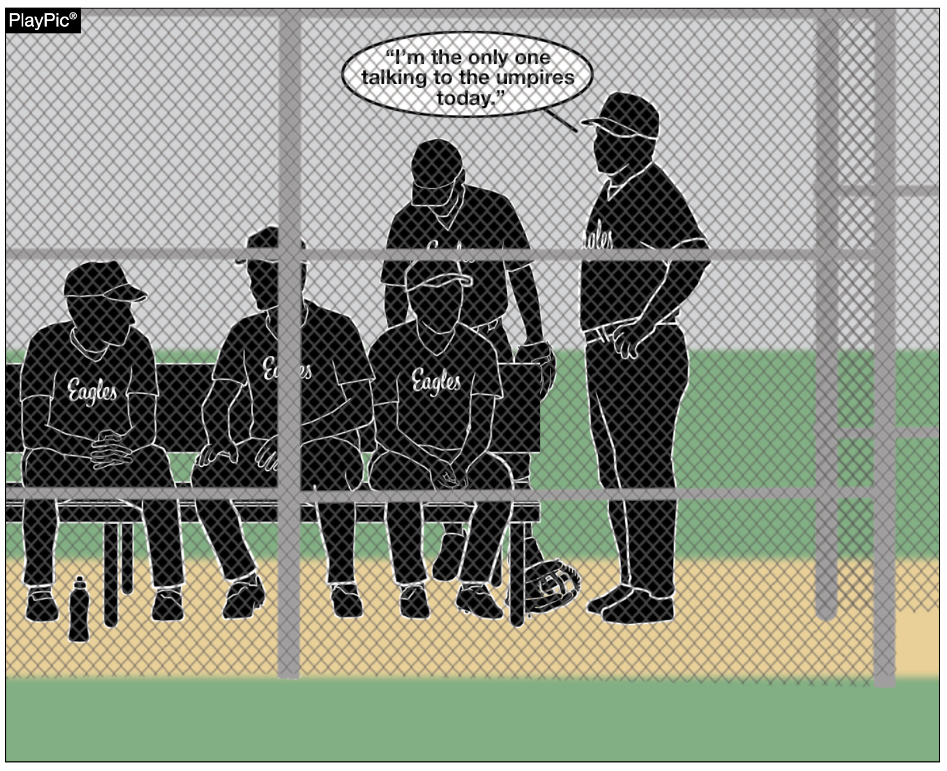
DISCIPLINE
Any unsportsmanlike conduct, arguing or disrespect directed toward umpires will result in disciplinary action, which may include warnings, restriction to the bench or ejection from the game (3-3-1 to 3-3-4 and 10-2-3).
These penalties are not punitive in nature – they are protective of the values that define high school sports: respect, integrity and personal responsibility.

Slide 42
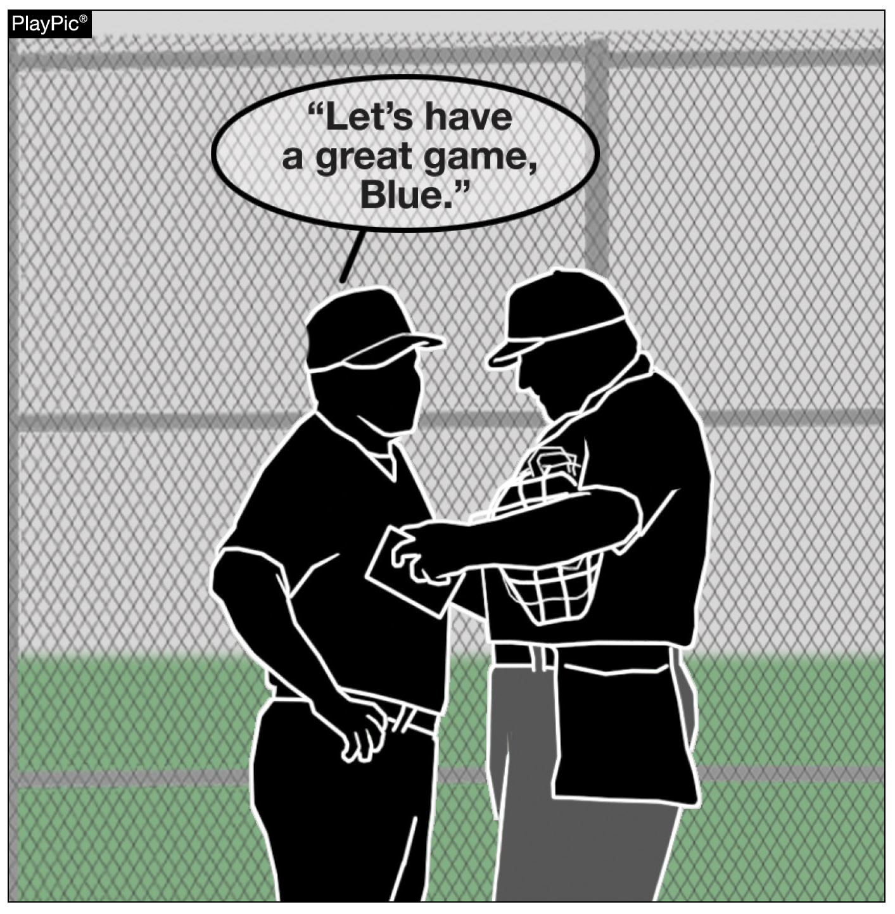
DISCIPLINE
Respect for officials is a reflection of the maturity, leadership and character we hope to instill in all participants through educational athletics.

Slide 43
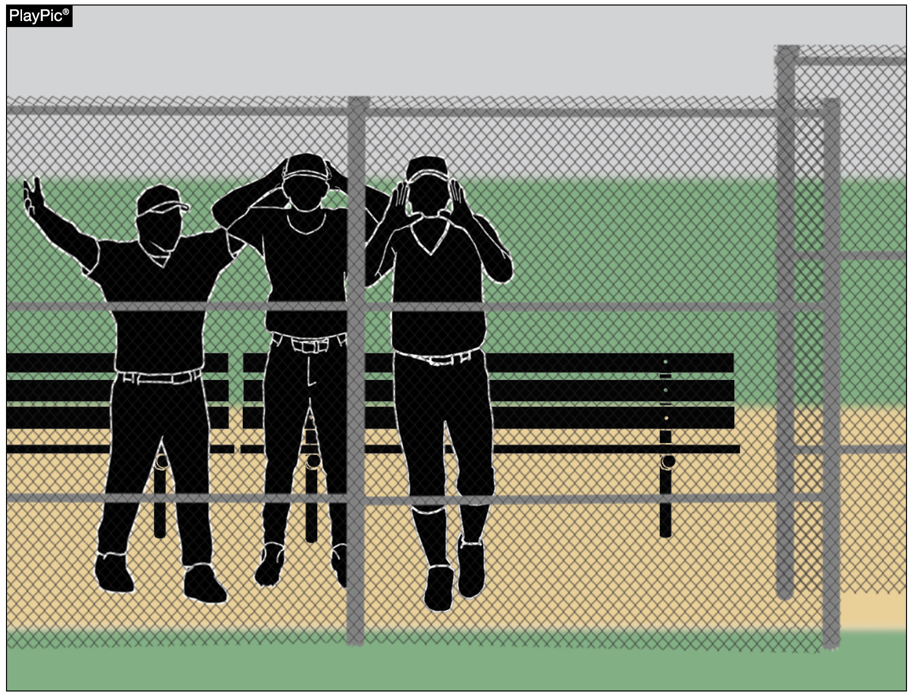
SPORTSMANSHIP
(BENCH JOCKEYING AND PROPS)
Bench jockeying can be considered as negative verbal comments, taunting or attempts to distract, intimidate or embarrass opponents or officials from the dugout – violates the standards of conduct expected in interscholastic competition.

Slide 44
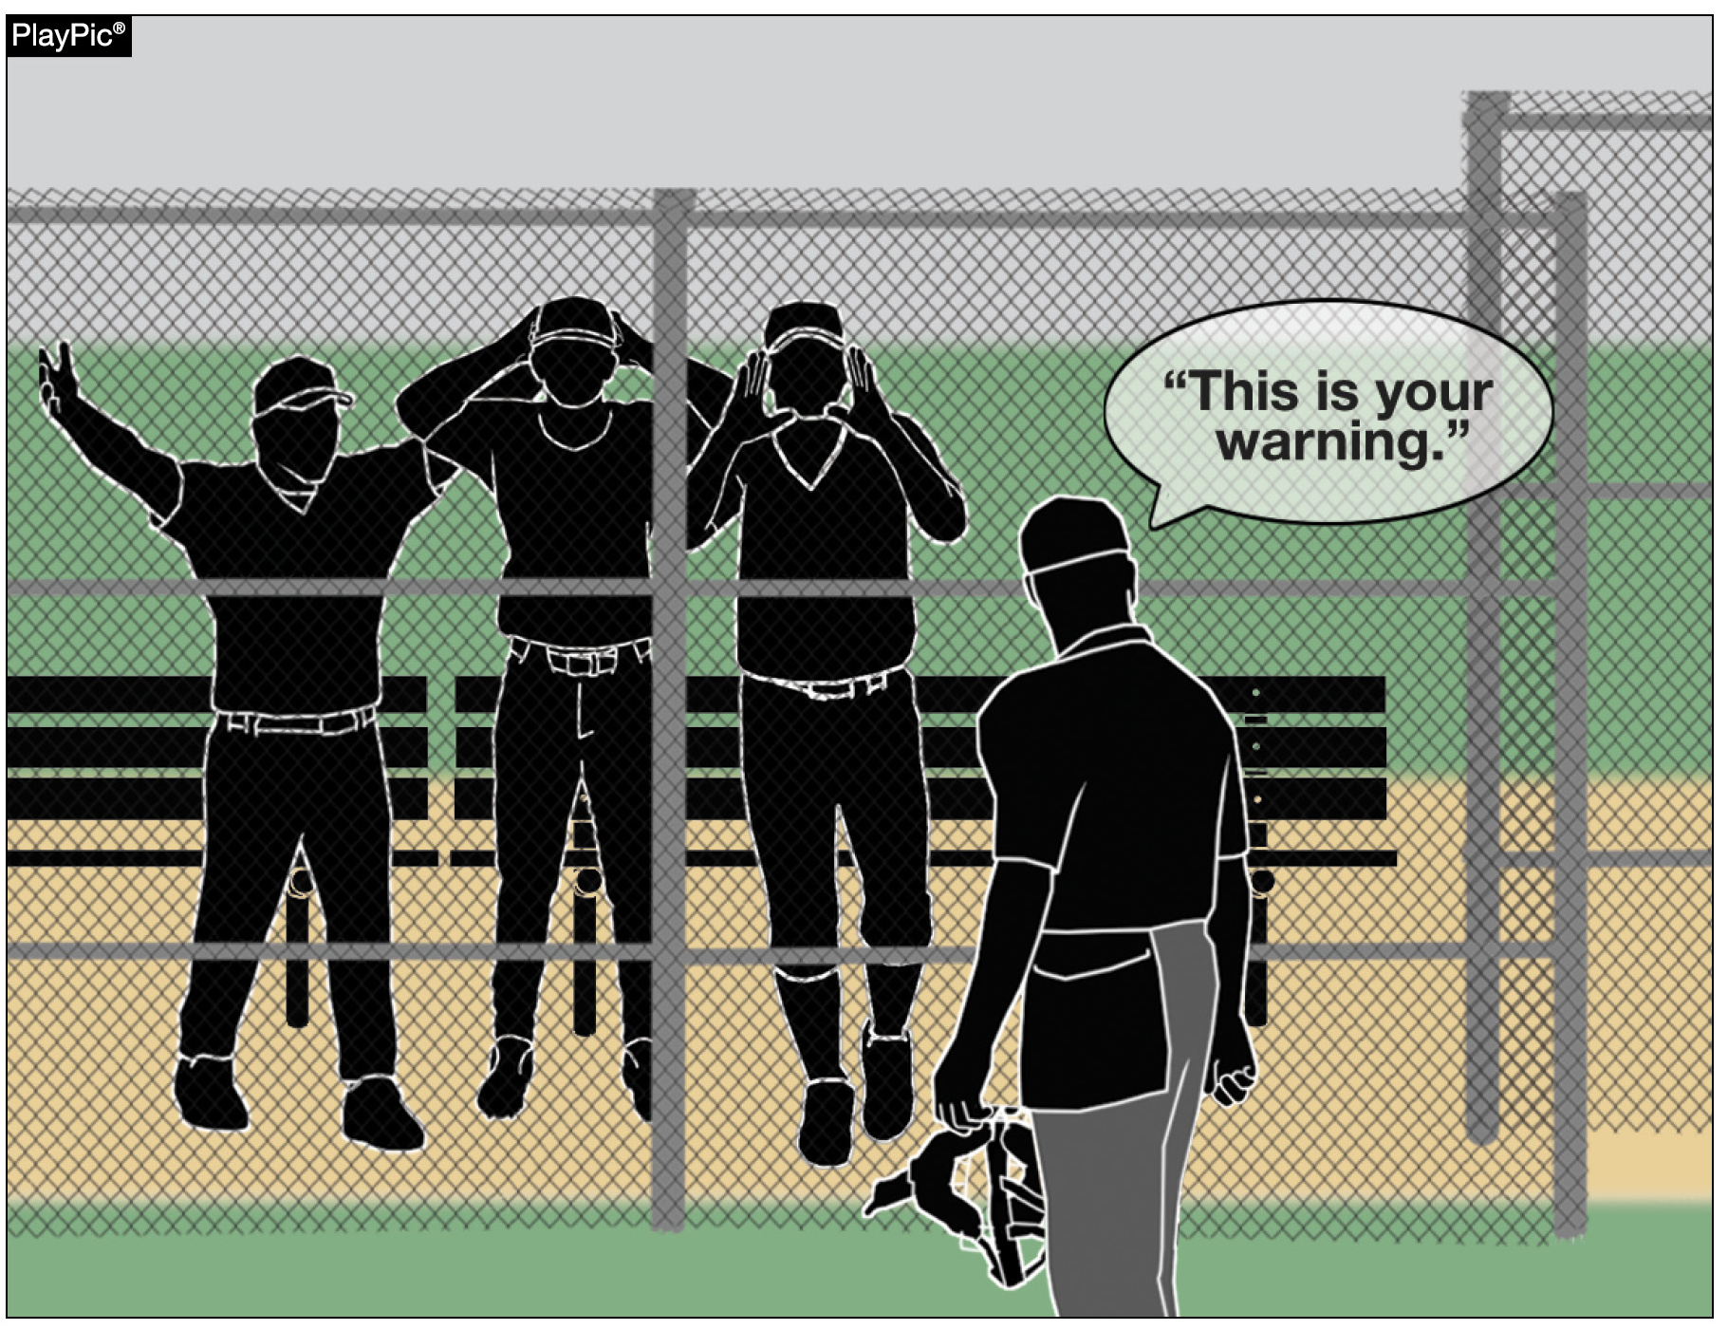
SPORTSMANSHIP
(BENCH JOCKEYING AND PROPS)
By rule, bench jockeying is prohibited and will result in warnings, restrictions or ejections as deemed appropriate by the umpire.

Slide 45
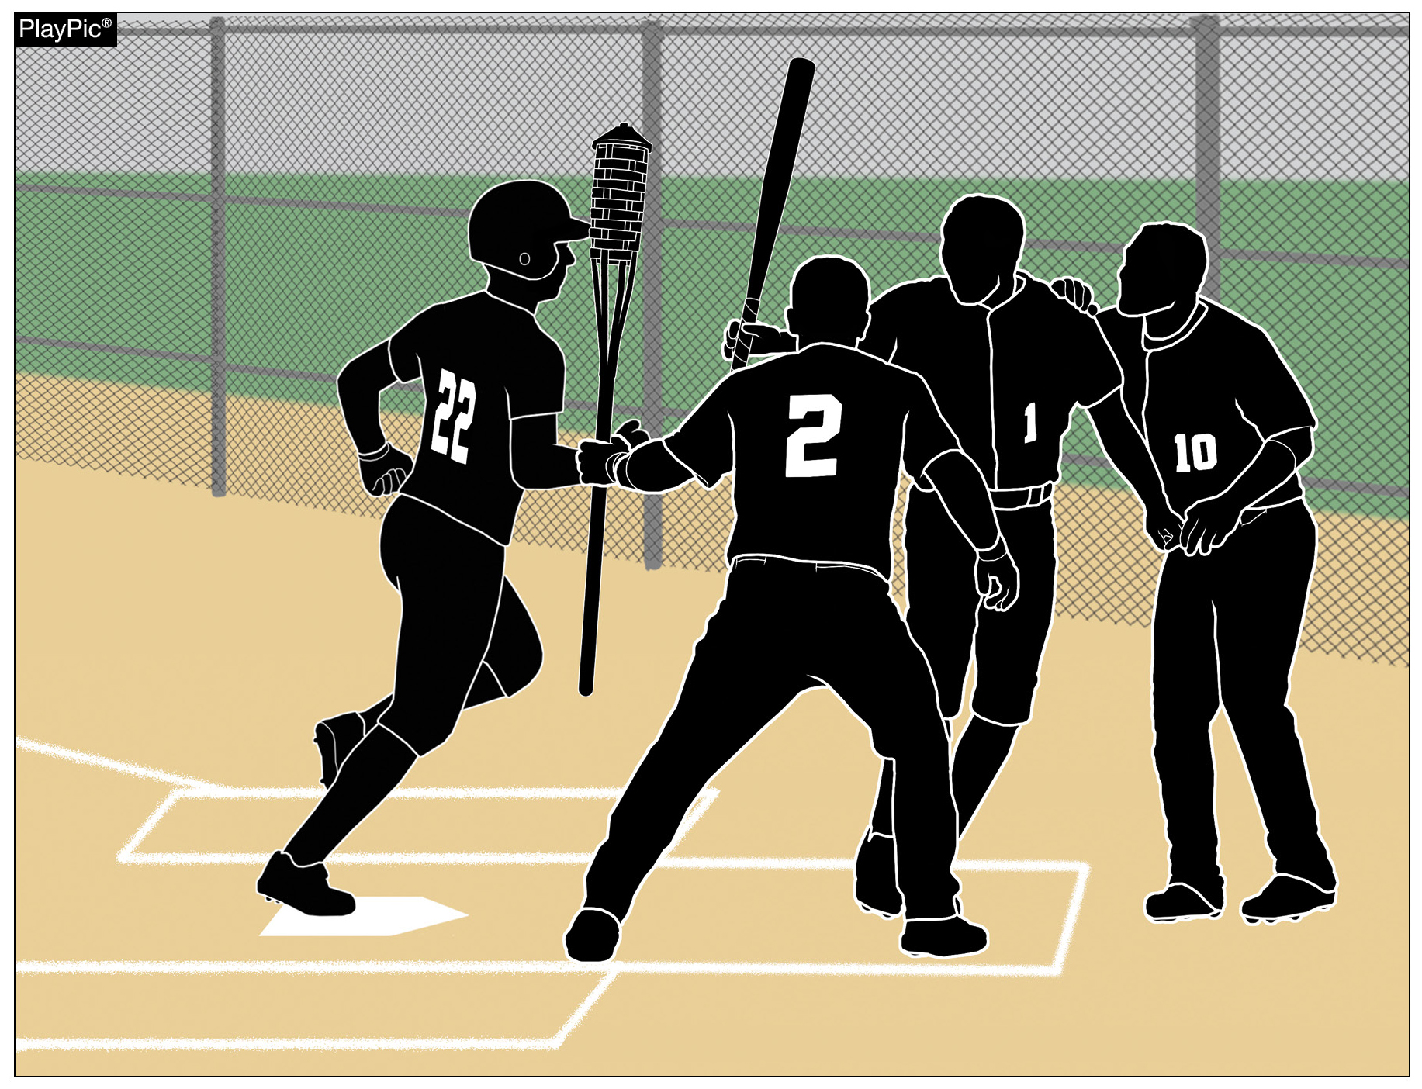
SPORTSMANSHIP
(BENCH JOCKEYING AND PROPS)
There is no logical purpose to have props at an education-based athletic event.
Props are prohibited and will result in warnings, restrictions or ejections as deemed appropriate by the umpire.

Slide 46
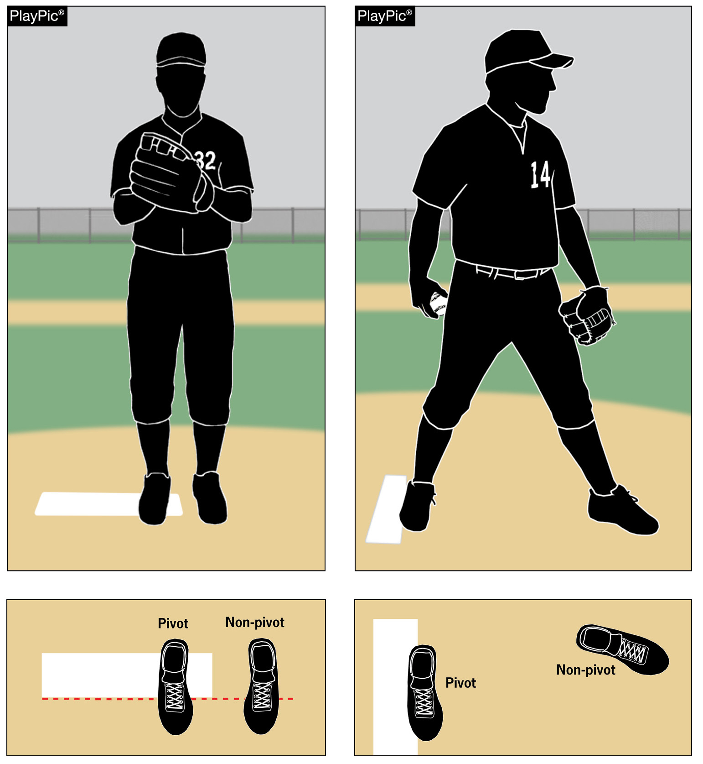
PROPER PITCHING POSITIONS
Pitchers are required to use one of two positions: the wind-up or the set.
It is important that umpires, coaches and players know what position the pitcher is using so they know which part of Rule 6 is in play.

Slide 47
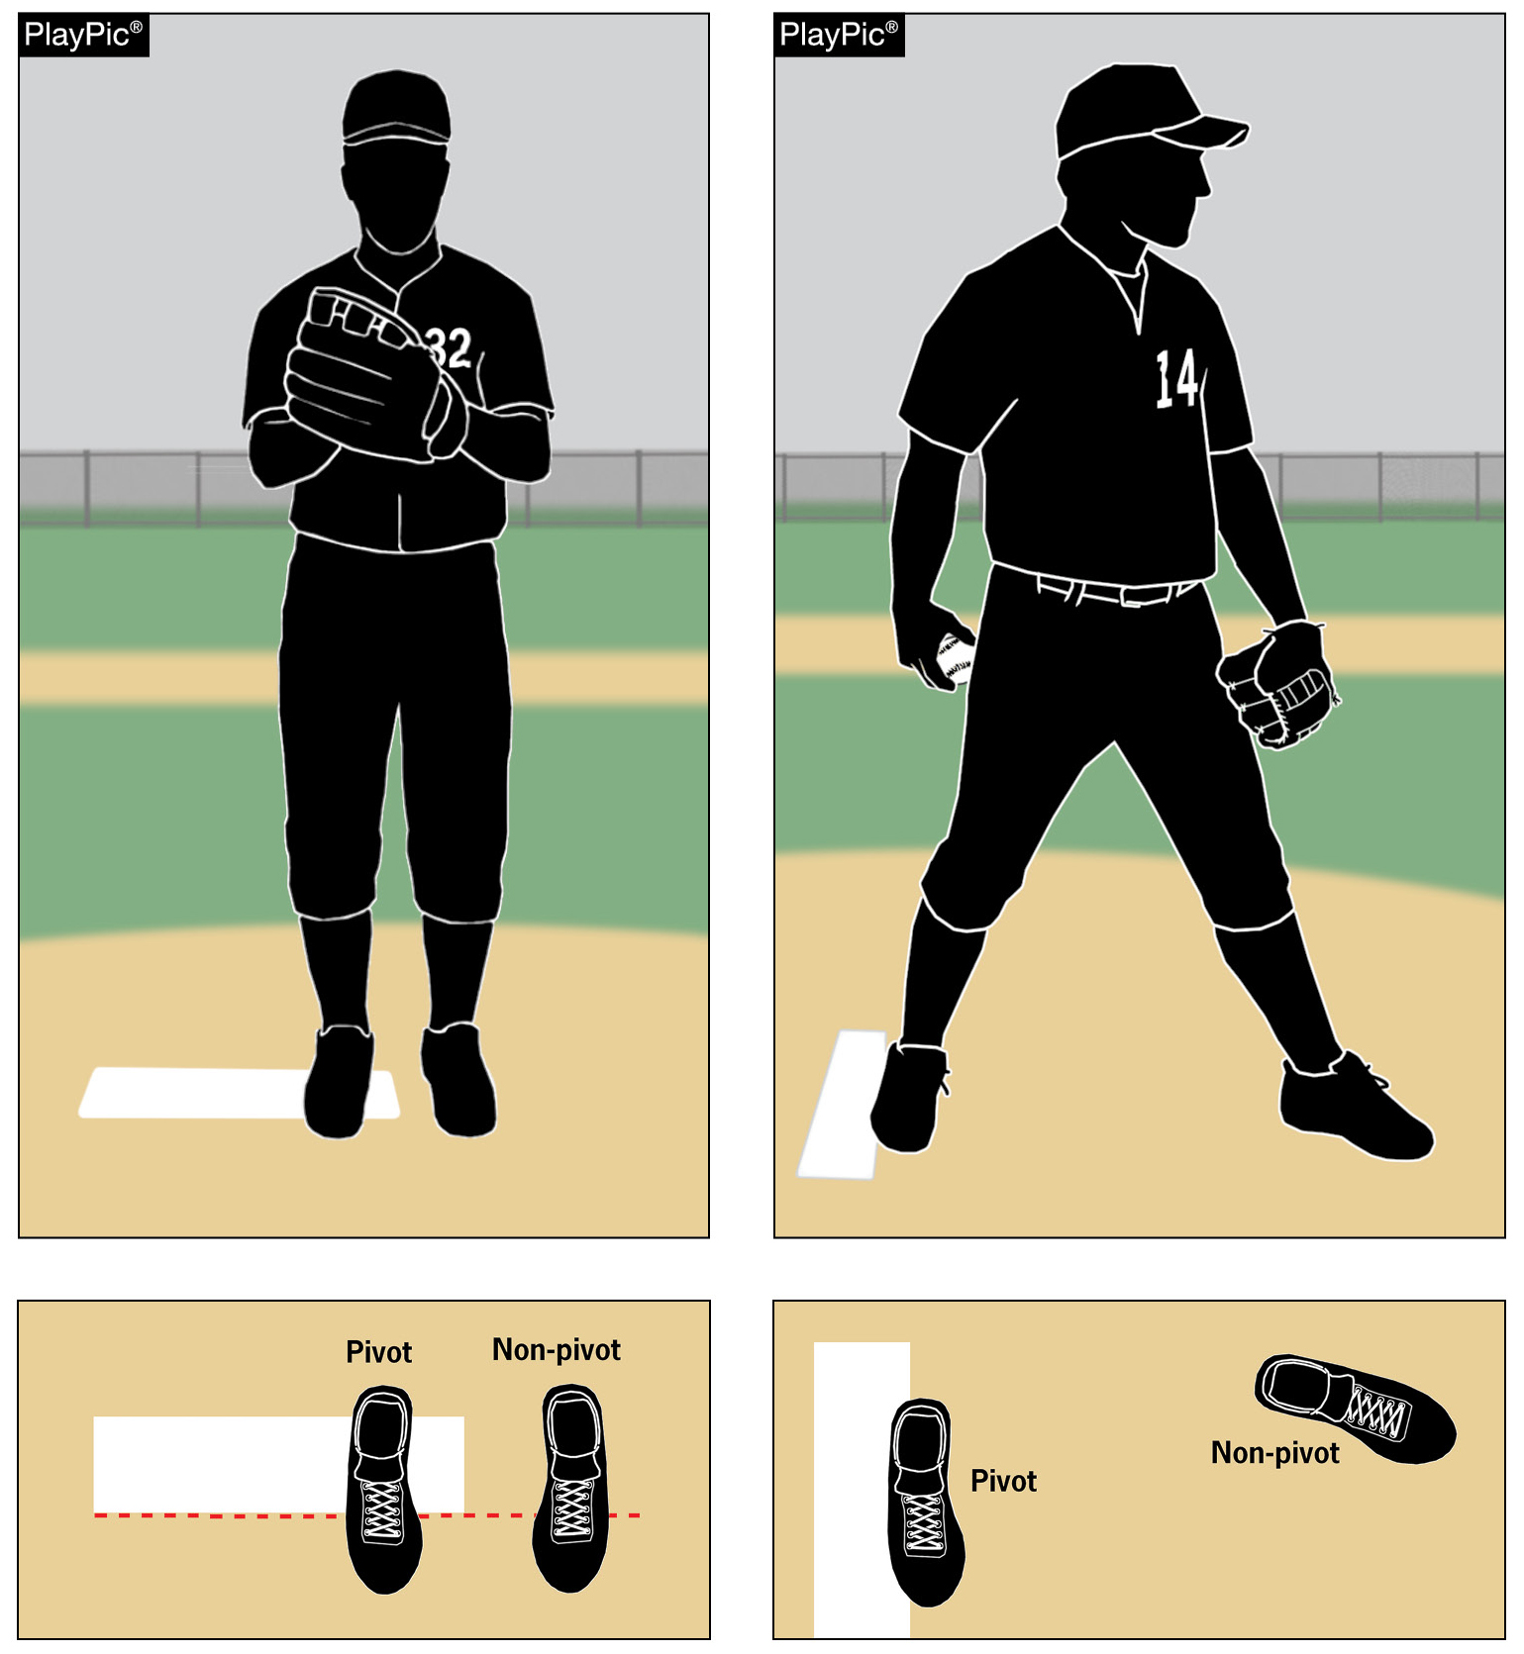
PROPER PITCHING POSITIONS
The position of the pivot foot determines which of the pitching positions is being used.
In the wind-up position, the pitcher’s pivot foot is in contact with the pitcher’s plate and is not parallel to it.
In the set position, the pivot foot is in contact with or directly in front of and parallel to the pitcher’s plate.

Slide 48
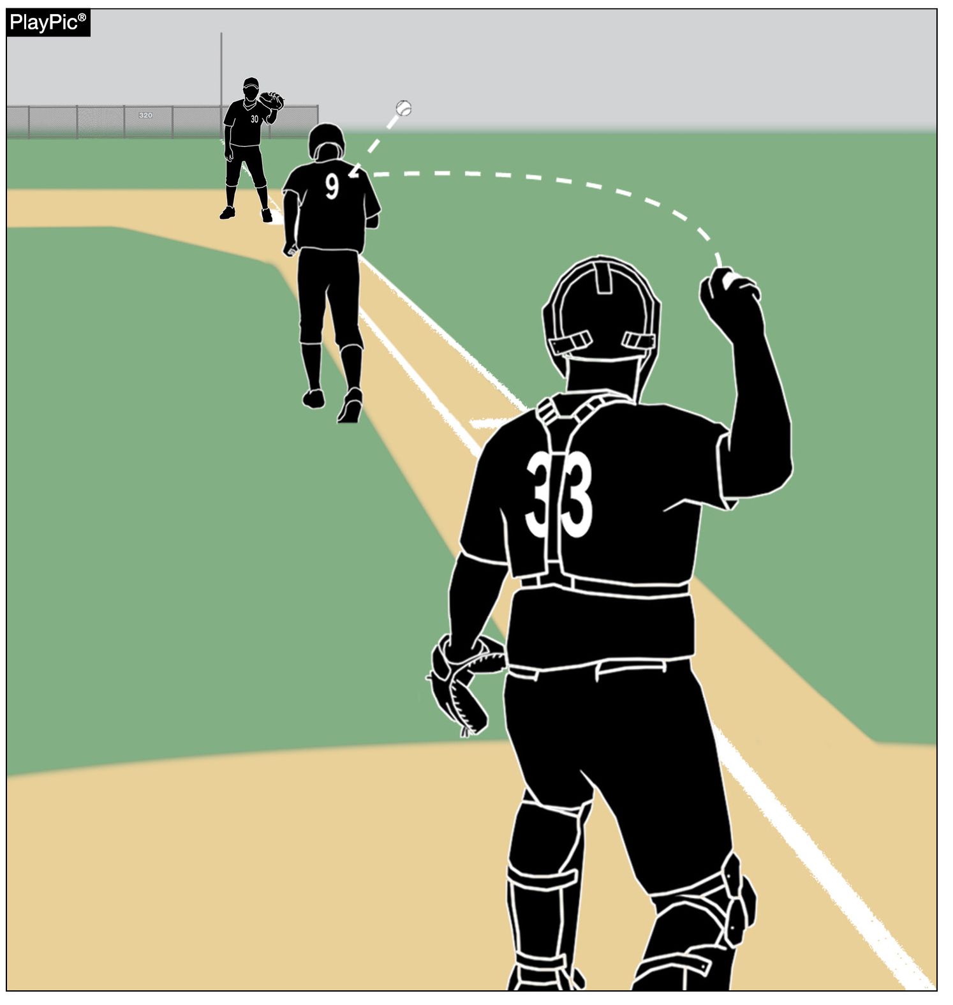
RUNNING LANE AWARENESS
Enforcing the running lane rule (8-4-1g) is vital for player safety, fairness and the educational goals of high school baseball.
The batter-runner must use the designated lane in foul territory during a play at first base.

Slide 49
RUNNING LANE AWARENESS
1. Safety – The lane prevents collisions and protects both the runner and the fielder.
2. Fair Play – Staying in the lane avoids unfair interference with defensive plays.
3. Consistency – Regular enforcement promotes accountability and discourages rule violations.
4. Education – Teaching proper lane use reinforces respect for the rules of the game.

Slide 50
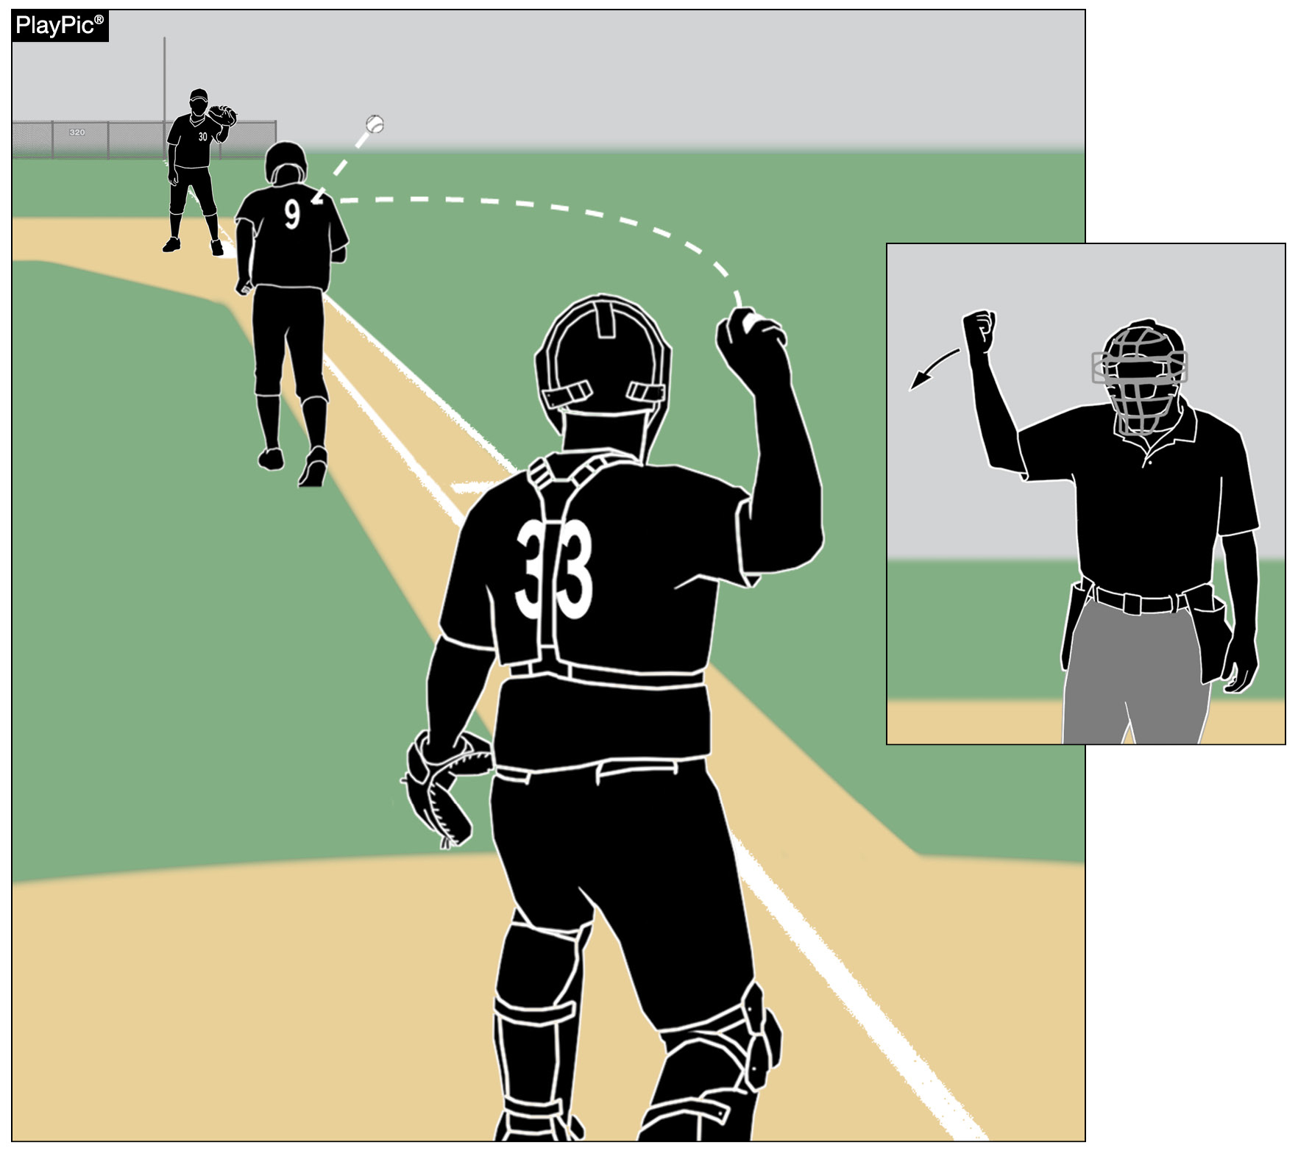
RUNNING LANE AWARENESS
Violations result in interference, with the batter-runner out and runners returned to their previous base.

Slide 51
NY State Adopted rules

Slide 52
NY State adopted rules – Page 69
1-2-9: We do have the option to allow a double-first base in 2026.
1-4-4: To allow for special occasions, commemorative or memorial patches, that will be uniformly placed, not to exceed 4 square inches, to be worn on jerseys in an appropriate and dignified manner without compromising the integrity of the uniform.
  If a school/coach contacts you or your chapter about this, refer them to NYSPHSAA.

Slide 53
NY State adopted rules – Page 69
4-2-2: 10 run rule. Each section has the option to approve the rule and then each league has the option to approve the rule.
4-2-4: Game-ending procedures may be determined.
4-3-1: Cross out! We do not have this rule.
4-4-1a: State associations are authorized to specify the time frame and/or circumstances before a forfeit shall be declared for a late arrival by one of the teams.
4-5-1: Protests are allowed in NY.
10-1-9: Each chapter received an updated uniform code.

Slide 54
Courtesy Runners REVIEW
At any time, the team at bat may use courtesy runners for the pitcher and/or the catcher.
If the offensive team bats around, the pitcher and/or catcher who had a courtesy runner on their behalf may bat in their lineup position.
The same individual player may not be used as a courtesy runner for both positions (pitcher and catcher) during the game.
Players who have participated in the game in any other capacity are ineligible to serve as courtesy runners.

Slide 55
Courtesy Runners REVIEW Continued
A player may not run as a courtesy runner for the pitcher or the catcher and then be used as a sub for another player in that half inning.
The home plate umpire shall record courtesy runners on their lineup cards and announce it to the official scorer.
A player who violates the courtesy-runner rule is considered to be an illegal substitute.
Should an injury, illness, or ejection occur to the courtesy runner, another courtesy runner for the pitcher or catcher may be used.

Slide 56
Situations and plays to discuss

Slide 57
Situation 1 – The Play
Prior to the start of the bottom of the 1st inning, the catcher, Rothrock, throws the ball down to second base on the last warm up throw from the pitcher. All defensive players from the infield come to the mound to encourage the starting pitcher.
The opposing coach comes out to you as the plate umpire and wants this charged as the team’s only player-to-player defensive meeting for the half-inning due to the new rule.
What is the ruling?

Slide 58
Situation 1 – The Answer
This is NOT a defensive player meeting.
The half-inning had not yet started and the ball had not yet been in play.
Casebook 3.4.6 Situation A (Page 42)

Slide 59
Situation 2 – The Play
The third baseman (Connors) tracking a high pop fly goes into out of play territory (dead-ball territory) with both feet.
The wind takes the ball back into live-ball territory so Connors jumps from the out of play territory (dead-ball territory), catches the ball while in the air, and lands on his stomach in live-ball territory.
What is the ruling?

Slide 60
Situation 2 – The Answer
This is NOT a catch as the left fielder has not re-established himself in live ball territory before making the catch.
The ball is dead (RIP), runners return, and the batter goes back to bat with a strike added to the count.
Rule 2-9-1 and Rule 5-1-1-i (2025 NFHS Interpretations Situation 12)

Slide 61
Situation 3 – The Play
Salada, the pitcher, attempts to pick off R1 Healey at first base.
Healey returns to first base prior to the throw but stands on the solid colored base. Rothrock, the first baseman, catches the pick off throw from Salada and tags Healey.
What is the ruling?

Slide 62
Situation 3 – The Answer
R1 Healey must return to the white color base, not the solid color base, on this play.
Healey would be called out.
Rule 8-2-2a

Slide 63
Situation 4 – The Play
Holliday is a starting player who has been removed from the game once. His coach wants him to re-enter, but he accidentally re-enters in the wrong position in the batting order and hits a single. The defensive coach comes to you as the plate umpire and notifies you of this issue.
Holliday is considered to be:
A. A legal substitute.
B. An unreported substitute.
C. An illegal substitute.
D. Batting out of order.

Slide 64
Situation 4 – The Answer
Holliday would be considered an illegal substitute.
  Rule 2-36-3b (page 27)
Holliday would be declared out and restricted to the bench for the remainder of the game.
  Rule 3-1-1 (page 28)

Slide 65

NFHS Network

Slide 66
NFHS Network
By 2028, every high school event
in America will be streamed live.
www.NFHSnetwork.com

Slide 67
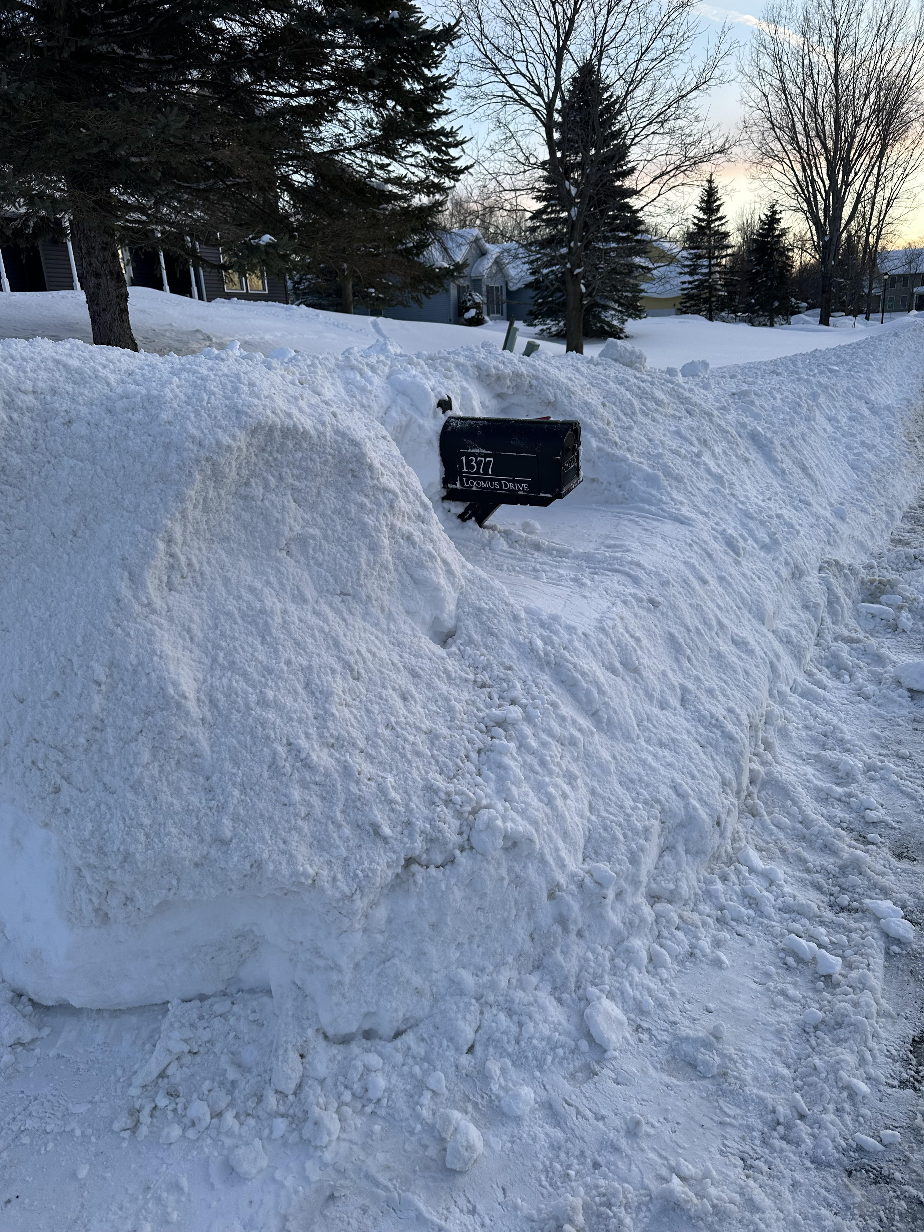
Thank You and have a great season!
Andy Draper
andy.draper1415@gmail.com

